Slide 1
Object detection in 20 years, 2001-2021
Zou

Slide 2
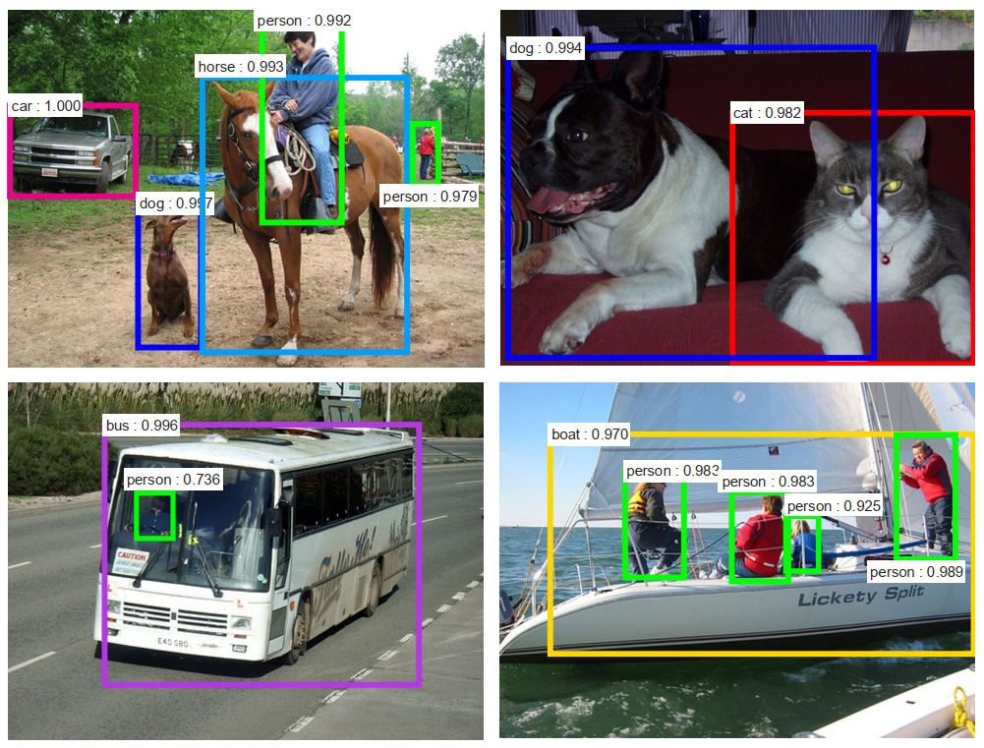
Definition
Input: 2D image
Output: object location (x, y, w, h), object class (confidence score)

Slide 3

Popular Pipeline
BBoxHead
NMS
extract feature
fuse feature
cls
N, num_classes
Backbone
Neck
conv or fc
N, 4
or
N, num_classes, 4
reg
ResNet, VGG...
FPN
NMS
RPN
RoIPooling

Slide 4
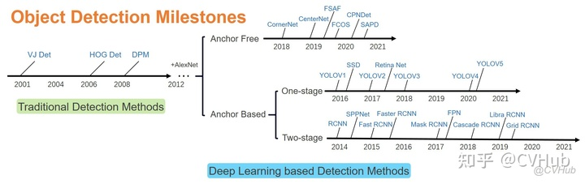
Road map
DenseBox
YOLOV1
2015
2016
Anchor Based Two-stage → Anchor Based One-stage → Anchor Free
Notes:
Anchor Based Two-stage → Anchor Based One-stage → Anchor Free

Slide 5
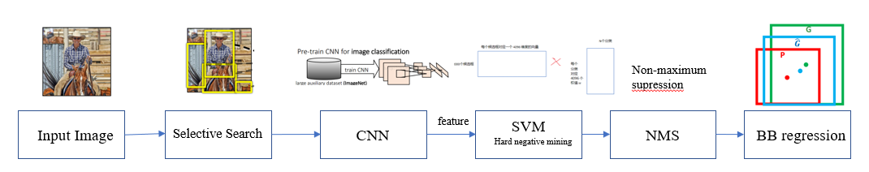
Anchor Based. Two Stage
Rich feature hierarchies for accurate object detection and semantic segmentation, CVPR 2014
R-CNN

Slide 6
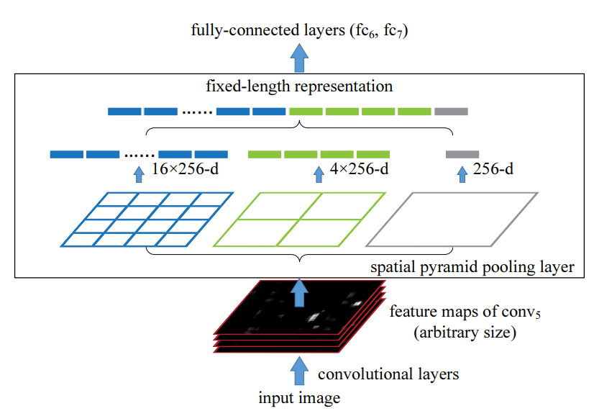
Anchor Based. Two Stage
Spatial Pyramid Pooling in Deep Convolutional Networks for Visual Recognition, CVPR 2014.
RoI pooling predecessor
SPPNet
Notes:
仍然使用SVM进行分类，需要事先准备好CNN特征

Slide 7
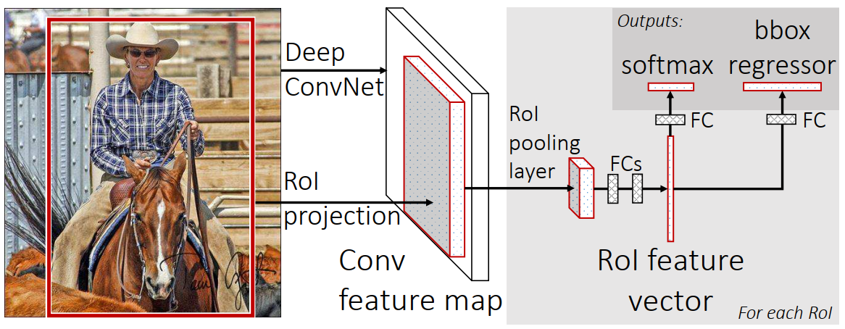
Anchor Based. Two Stage
Fast R-CNN, ICCV 2015.
Notes:
Selective search

Slide 8
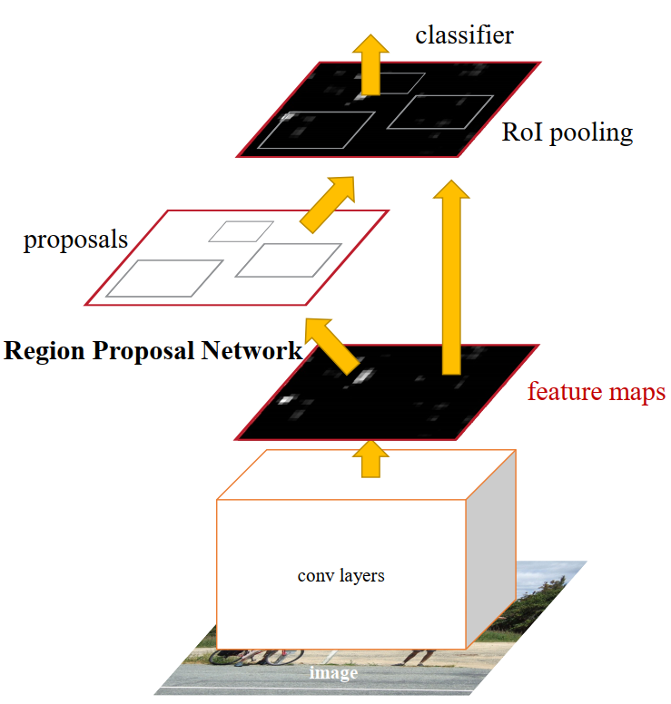
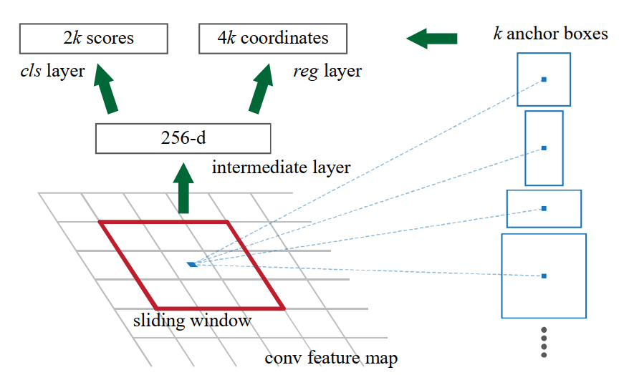
Anchor Based. Two Stage
Faster R-CNN, NIPS 2015.
First use of anchor
RPN
1*1 conv
3*3 conv
Notes:
RPN只预测前景和背景

Slide 9
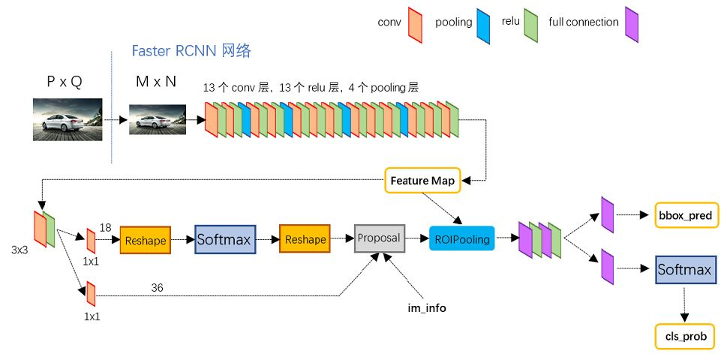
Anchor Based. Two Stage

Slide 10
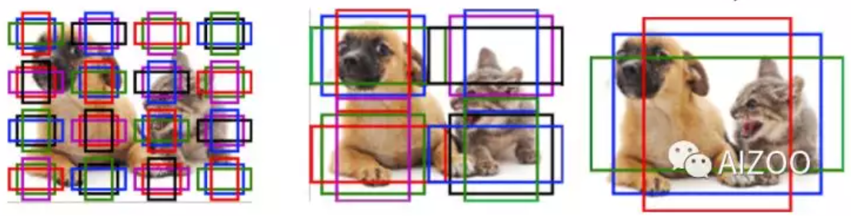
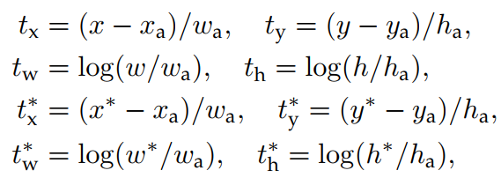
Anchor Based. Two Stage
Why do we need anchor?
Encode prior knowledge about objects’ shape and size
Easy to converge

Slide 11
Anchor Based. Two Stage
How to caculate loss?
Select target to define pos and neg bbox: pos_iou: 0.7, neg_iou: 0.3.
Positive bbox: cls, reg; Negative bbox: only cls.
gt_1
pred
pred
gt_2

Slide 12
Anchor Based. One Stage
Why do we need one stage?
detection speed
One stage vs Two Stage
One stage detector can be viewed as RPN-only two-stage detectors.
RPN

Slide 13
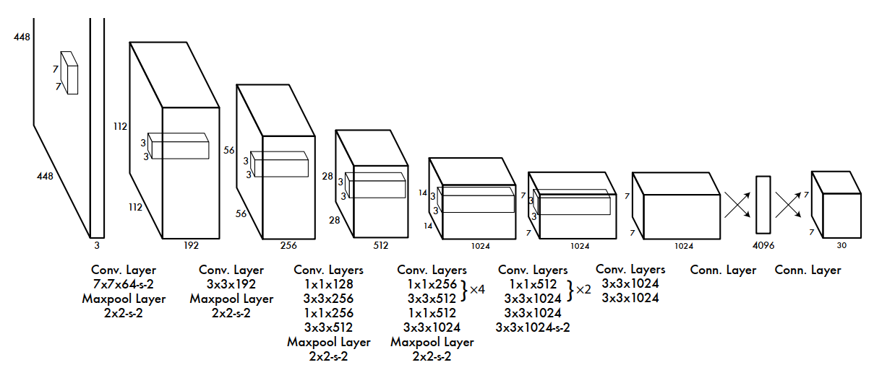
Anchor Based. One Stage
YOLO v1, CVPR 2016.
just like RPN!

Slide 14
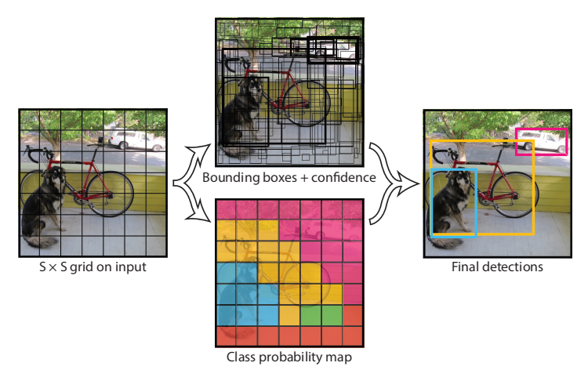
Anchor Based. One Stage
YOLO v1, CVPR 2016. (Anchor Free)
predict two bboxes each grid
Notes:
每个grid的target是中心点落入该grid中的gt bbox

Slide 15
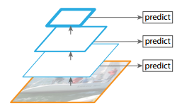
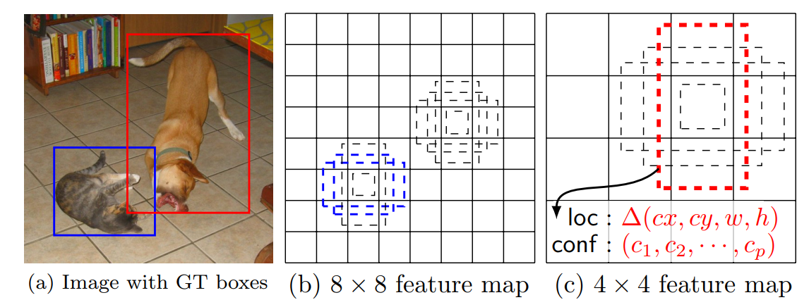
Anchor Based. One Stage
SSD, ECCV 2016.

Slide 16
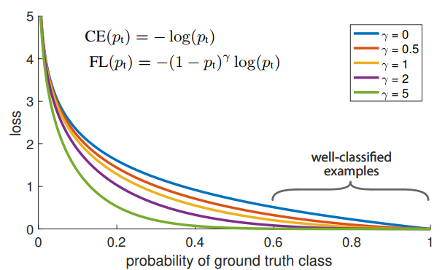
Anchor Based. One Stage
RetinaNet, ICCV 2017. (Focal Loss)
Two stage detector uses RPN to select high-quality proposals for the second stage, therefore avoids foreground-background class imbalance problem.
One stage detector suffers from extreme foreground-background class imbalance problem.

Slide 17
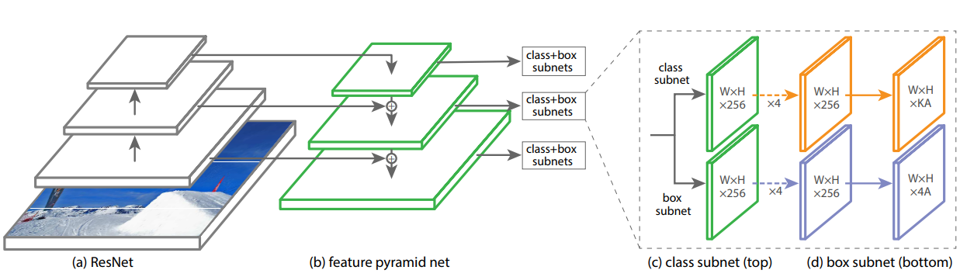
Anchor Based. One Stage
RetinaNet

Slide 18
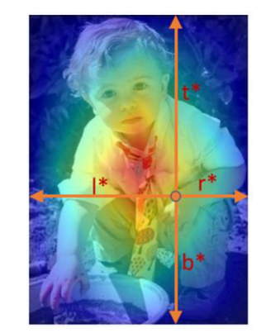
Anchor Free
Why do we need anchor free?
Reduce manually designed hyperparameters
Smaller computational burden because of fewer redundant boxes
Anchor Free vs Anchor Based
Anchor Free can be understood as a detector where the anchor is a non-bbox (point, region)
FCOS

Slide 19
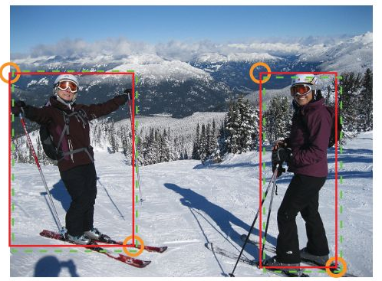
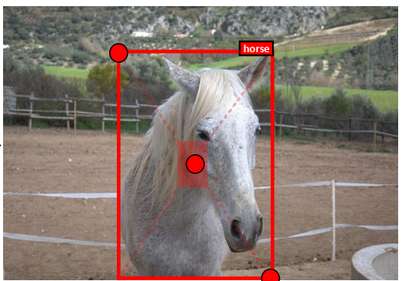
Anchor Free
region
point
region
CornerNet, ECCV 2018
FCOS, ICCV 2019
CenterNet, ICCV 2019

